Slide 1

EVENT MANAGEMENT
BY
SANJEEVI.M.B

Slide 2
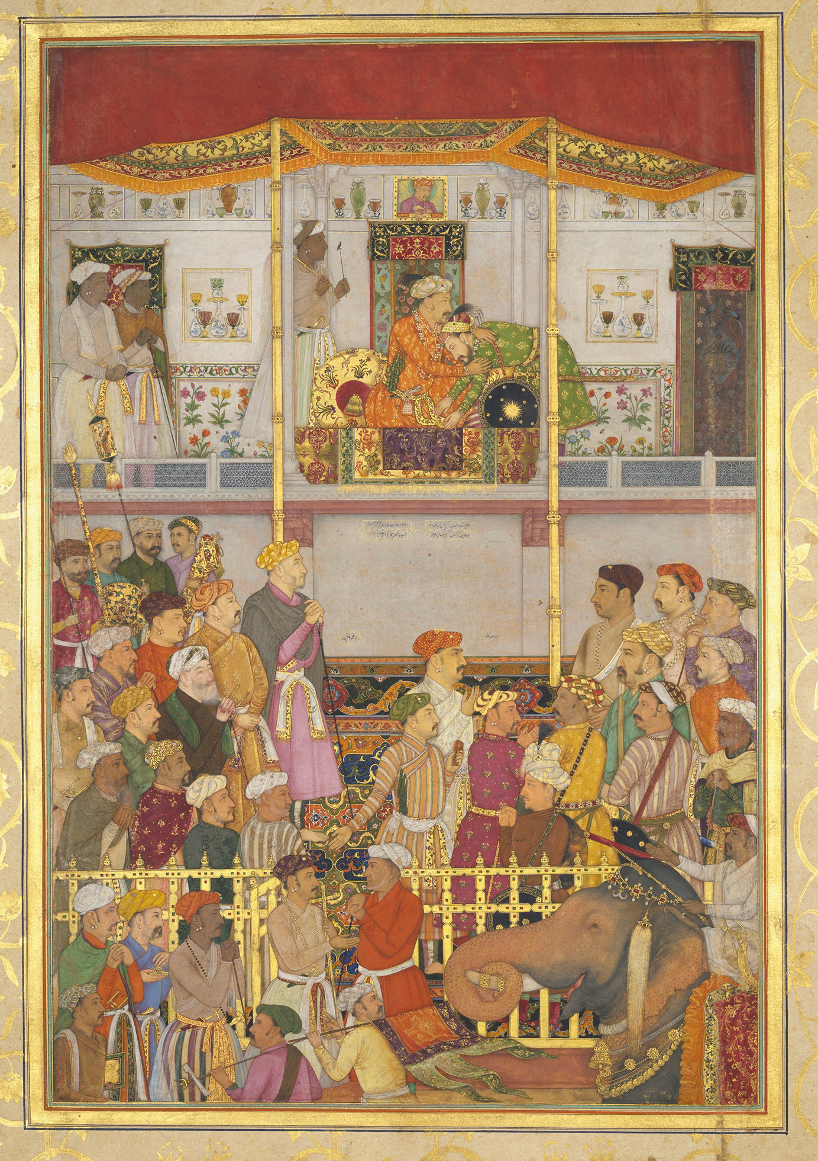
Historic proof
HISTORICAL PROOF
JAGANGHIR THE SON OF AKBAR
RECEIVE THE HOLY KURAN FOR THE BEST WARRIOR SELECTION
IF EVENT MANAGEMENT IS AN ART WE HAVE TO EXCEUTE PROPERLY

Slide 3
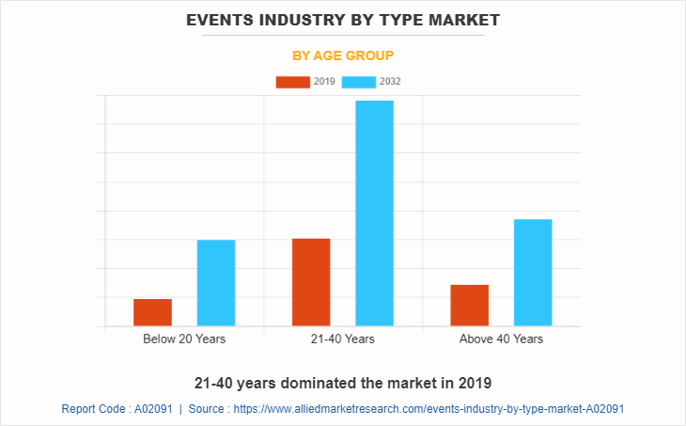
VIEW OF STATISTICS
2019 WAS THE STARTUP OF EVENT MANAGEMENT OF THR DIGITAL INDIA
BUT DUE IN SOME YEARS IT WILL BE THE MOST WANTED ONE INE YEAR OF 2026

Slide 4
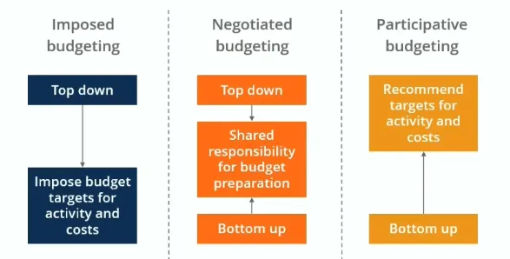
FINANCE AND BUDGET

Slide 5
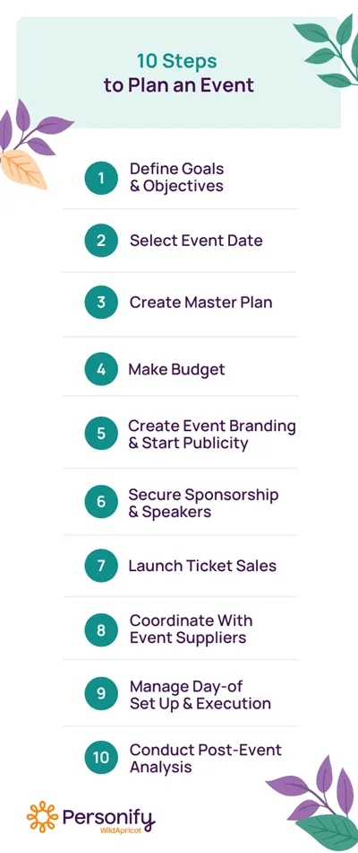

Slide 6
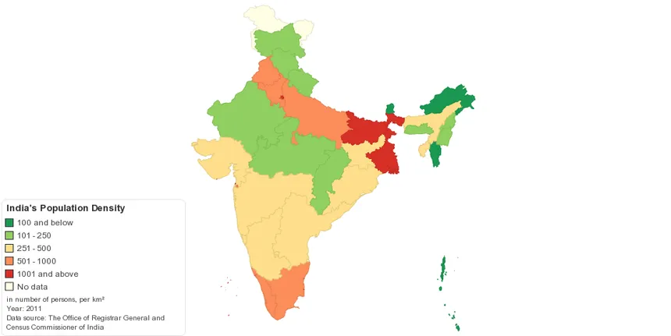







EVENT CHART OF INDIA
THE EVENTS IN INDIA IS HIGH IN NUMBER
THE DARKER COLOUR EXPRESSES HIGH NUMBER OF EVENTS
THE FADER THE COLOUR THE LESS NUMBER OF EVENTS

Slide 7
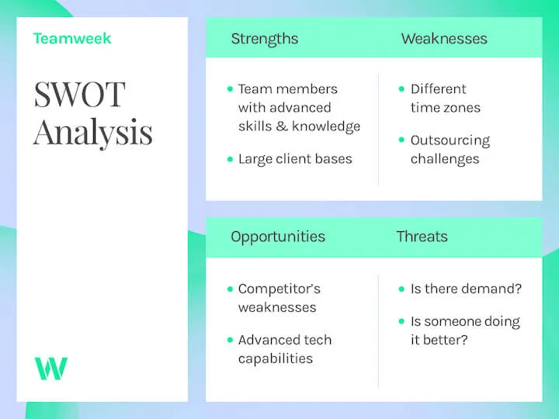

Slide 8
Keys to success
WE HAVE TO ADJUST BASED ON OUR BUDGET
PEOPLES EXPECTATION MAY GO BETTER BUT WE CANNOT ATTAIN IT AT EACH AND EVERY POINT
IT CAN BE ACHIEVED BASED ON EXPERICENCE AND BY ONGOING ON SMALL STEPS

Slide 9
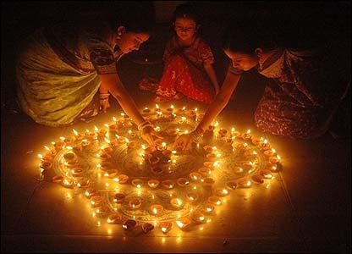
POINTS TO REMEMBER
AS THE BEAUTIFUL COUNTRY INDIA IS ALL OF DIFFERENT COLOURS AND CULTURES SO AS ALSO AS THE PEOPLE MIND
INFORMATION IS THE WEALTH IN THE HERE ,THE MORE WE SHRINE
FOR EXAMPLE WE HAVE 29 STATES AND EACH STATE
FOLLOWS A VARIOUS WAY OF EVENTS AND INFORMATION

Slide 10
TIME TO ASK ?

Slide 11
The most successful event is the one that achieves the goal and exceeds the value of our expectation
Thanking for the opportunity and the respectable audience and teachers of
Ppg college of arts and science

